Slide 1


Sales Performance Analysis
1

Slide 2

Agenda
Problem Statement
Approach
Data Overview
Project Workflow
Exploratory Data Analysis
Key Insights
Recommendation
Dashboard Preview

Slide 3

Problem Statement

Slide 4
Problem Statement
Sales teams often lack a clear, data-driven understanding of regional performance, making it difficult to identify growth opportunities and optimize resources. This project aims to analyse and visualize regional sales data to uncover trends, evaluate profitability, and support strategic decision-making.
What’s the Business Question?
Inconsistent revenue and profit performance across U.S. regions Lack of visibility into seasonal swings, top SKUs, and channel profitability Goal: Leverage 5 years of historical data to pinpoint growth levers and optimize strategy

Slide 5
Approach

Slide 6

Approach – Two phase solution
Exploratory Data Analysis
Interactive Dashboard
1
2
Dive into historical sales, margins, products, channels, regions
Build a live view for business Users to self serve insights
Surface trend, outliers & relationships
Enable ad-hoc slicing by time, product, region, channel

Slide 7
Project Workflow

Slide 8
Project Workflow
Define Business Objective
Collect & Consolidate Data
De
De
1
1
1
Understand the core problem and expected business outcomes.
2
Gather multi-source sales data (Excel sheets) and understand schema.
De
Pre-processing & Cleaning
Data Loading & Initial Exploration
De
1
1
4
Handle nulls, join tables, format dates, and normalize columns.
3
Load into Colab for initial profiling and data understanding using Python.
De
Dashboarding & Recommendations
Exploratory Data Analysis (EDA)
De
1
1
5
Visualize trends, compare performance, and extract key insights.
6
Build Power BI dashboard and present strategic findings.

Slide 9
Exploratory Data Analysis

Slide 10
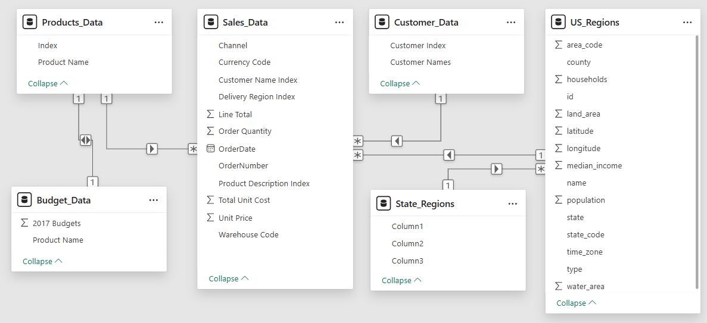
Raw Dataset Structure – Before Processing
Sales, products, budgets, customers, regions, and states were spread across unlinked tables. No relationships were defined initially— Pre-processing was required to clean, normalize, and join them for analysis.

Slide 11

Exploratory Data Analysis (EDA)
Uncovering patterns, trends, and business insights from historical data !
Understanding the “What, Where & Why” behind the sales numbers
Exploring data through visuals, aggregations, and comparisons
Laying the groundwork for informed recommendations

Slide 12
EDA: Step‑by‑Step Process
Import Libraries
Load Data
Initial Exploration
Pre-processing & Cleaning
Feature Engineering
EDA & Visualization
Key Insights
Recommendations

Slide 13
Pre-processing & Feature Engineering
The necessary steps applied to prepare this dataset for analysis.
Set header row for state – region table
Merge Sales, Customers, Products, Regions, State–Region & Budgets tables
Drop redundant columns
Standardize column names to lowercase
Select key columns that are used for that analysis
Rename columns to more sensible names
Create profit and profit_margin_pct columns
✅ Note: No missing values or duplicate rows were found in the dataset

Slide 14
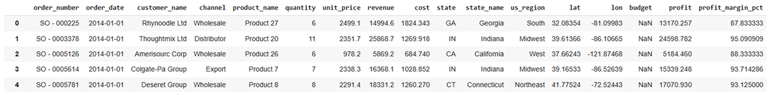
Final Dataset Structure – Ready for Analysis
Identifiers: order_number, order_date, customer_name, channel, product_name Financials: quantity, unit_price, revenue, cost, profit, profit_margin_pct
Calendar: order_month_name, order_month_num, order_month
Geography: state (code), state_name, us_region, lat, lon Planning: budget (2017)

Slide 15

Charts & Insights

Slide 16
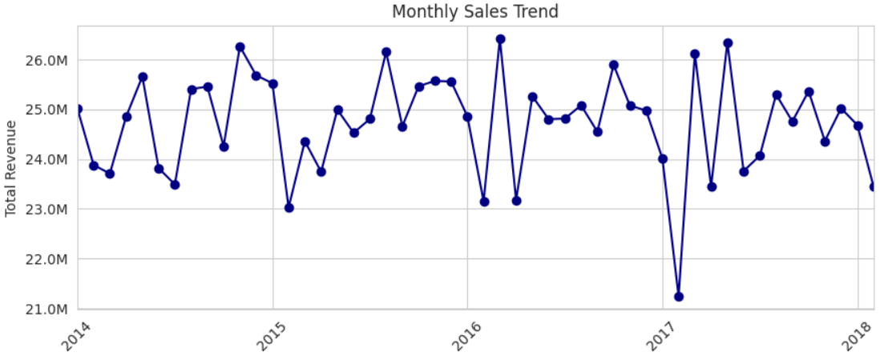

Monthly Sales Trend Over Time
Insights
Consistent sales cycle: $24M to $26M.
Seasonal peaks: Late spring/early summer (May-June).
Annual low: January.
Notable outlier: Sharp revenue drop in early 2017.

Slide 17
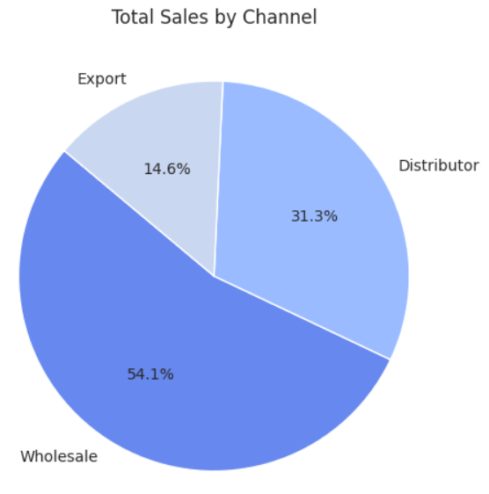
Sales by Channel
Insights
Wholesale dominates: Generates the majority of total sales at 54.1%.
Distributor is significant: Contributes a substantial 31.3% to total sales.
Export is a smaller portion: Accounts for 14.6% of the total sales.

Slide 18
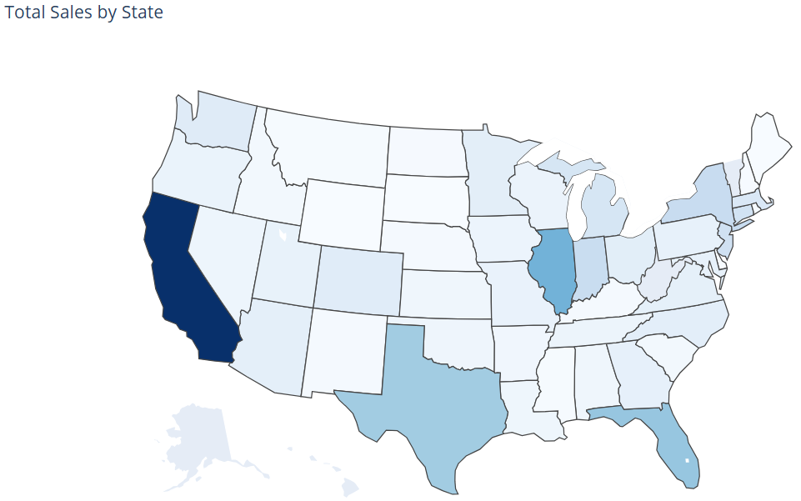
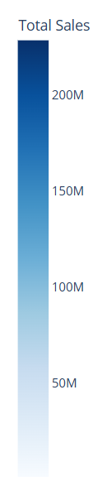
Total Sales by State (Choropleth Map)
Insights
California leads: Highest total sales.
Texas, Florida, Illinois: Significant sales.
Varying sales: Other states show moderate to low sales.
Visual pattern: Higher sales in larger and some coastal states.

Slide 19
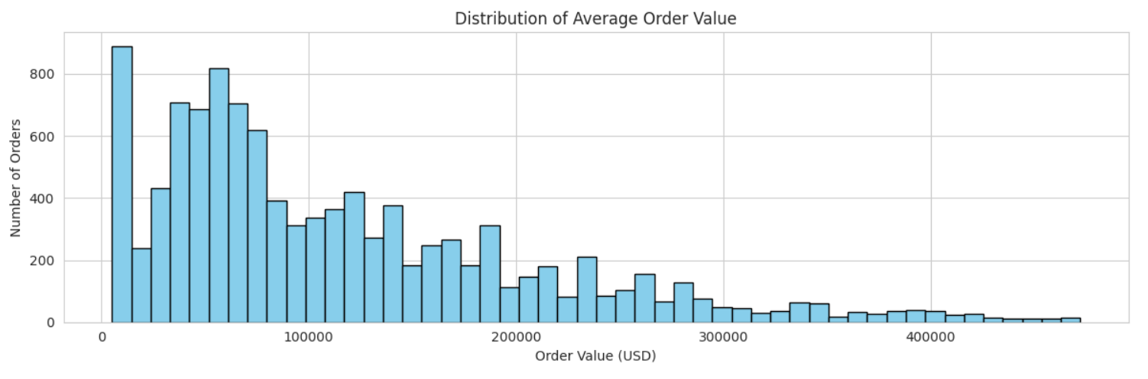
Average Order Value (AOV) Distribution
Insights
Low average order values are frequent.
Distribution is right-skewed (long tail of high-value orders).
Multiple order value clusters exist.
Higher order values are less common.

Slide 20
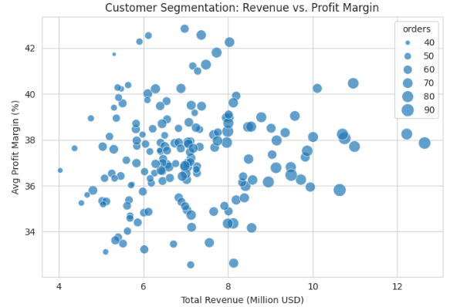
Customer Segmentation: Revenue vs. Profit Margin
Insights
Those Uniform 35–40 % margins confirm strong, consistent pricing and cost control.
>$10 M clients with <36 % margins reveal discounting hotspots—re evaluate large‑account terms.
$6–9 M clients with >40 % margins are high‑value candidates for targeted upsell.

Slide 21
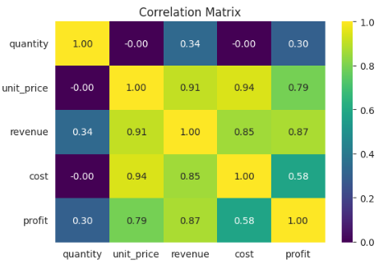
Correlation Heatmap of Numeric Features
Insights
Unit price is the primary driver, showing very strong correlations with cost (0.94), revenue (0.91) and profit (0.79).
Revenue & profit maintain a high link (0.87), underscoring direct profitability gains.
Quantity’s impact is minimal (≤ 0.34 vs. financials), indicating volume plays a secondary role.
Cost vs. profit correlation (0.58) is moderate, suggesting margin improvement focus should center on pricing.

Slide 22
Key Insights

Slide 23


Key Insights
Strong Seasonality: Revenues remain relatively consistent between $24M and $26M monthly, with predictable peaks in May–June and a consistent annual low in January.
Product Concentration: Top-performing products contribute disproportionately to total revenue, with the top 10 products generating the majority of sales.
Channel Imbalance: Wholesale dominates sales volume (54.1% of total), while Export demonstrates the strongest profit margins (~38%).
Geographic Concentration: California alone accounts for 19.5% of total revenue ($228.8M), with the West region showing both high sales and the highest profit margin (37.5%).
Customer Segmentation Opportunities: A clear segment of mid-revenue clients ($6–9M) achieves exceptional profit margins (>40%), representing high-value upsell candidates.
Order Value Distribution: Average order values are heavily right-skewed, indicating frequent small transactions alongside a valuable long tail of high-value orders.

Slide 24
Recommendations

Slide 25

Recommendations
Leverage Seasonal Peaks: Capitalize on the predictable late spring/early summer (May–June) revenue surge with targeted marketing and inventory planning, while developing strategies to mitigate the January sales dip.
Optimize Channel Strategy: Rebalance the sales mix by incentivizing higher-margin Export sales without sacrificing wholesale volume, and review terms for large distributor accounts to protect margins.
Focus on High-Value Segments: Implement targeted upsell campaigns for the identified $6–9M clients with >40% margins, and re-evaluate pricing or terms for >$10M clients with sub-36% margins.
Diversify Geographic Reliance: Develop targeted initiatives in high-potential states like Texas, Florida, and Illinois to reduce over-dependence on California and stabilize regional revenue swings.
Enhance Order Value: Introduce bundling, minimum order incentives, or tiered pricing to increase the average order value and shift the distribution away from its current low-value concentration.

Slide 26
Dashboard Preview

Slide 27
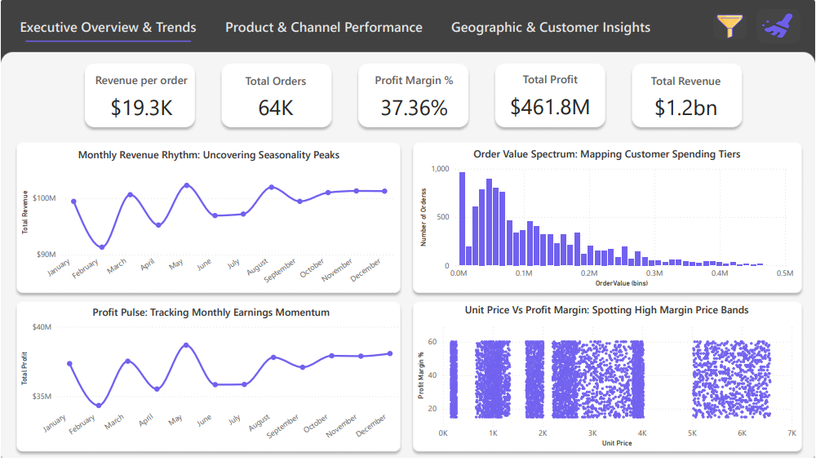
Page 1 - Performance Summary

Slide 28
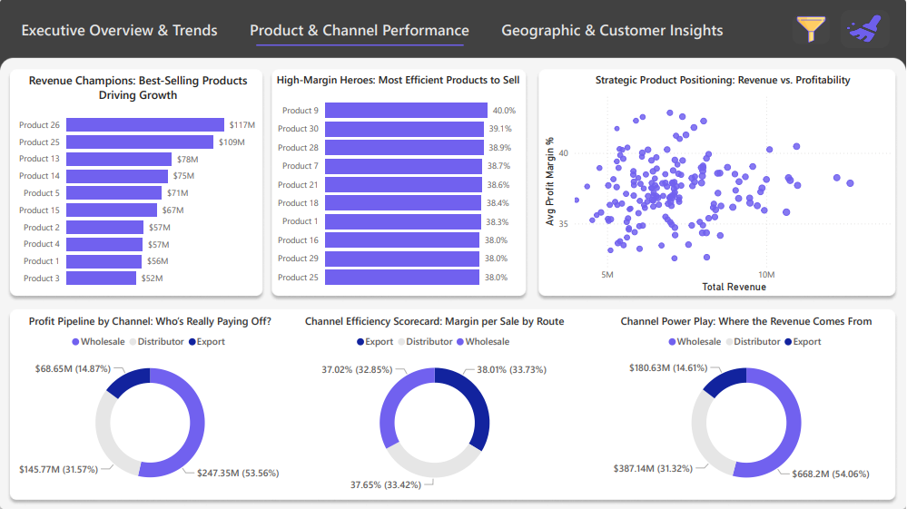
Page 2 - Customer Segmentation

Slide 29
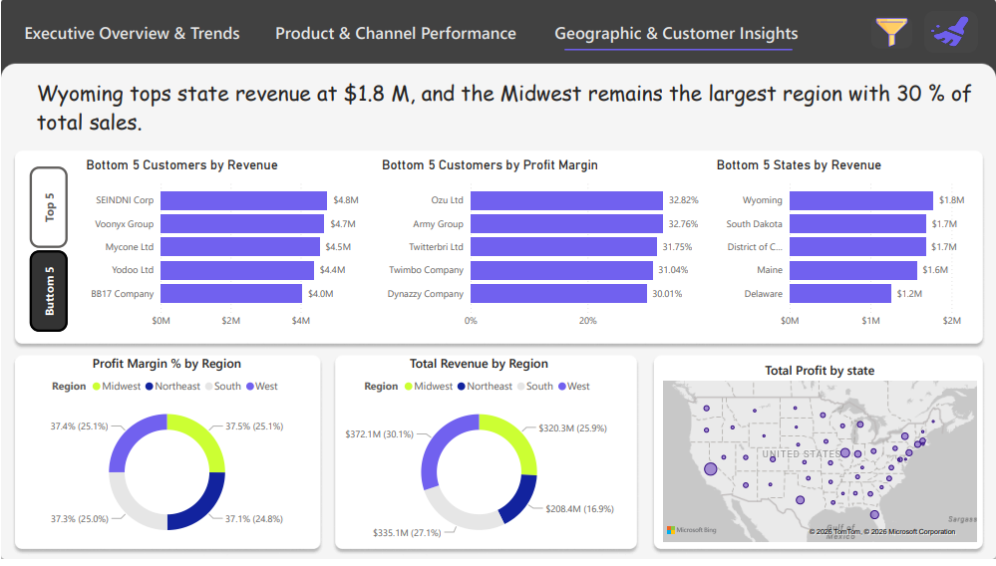
Page 3 - Revenue Scenarios

Slide 30
Conclusion

Slide 31

Conclusions
Completed end‑to‑end EDA and interactive Power BI dashboard, surfacing seasonality, SKU, channel & regional insights. Insights inform sales policies and operational planning (store & warehouse prep aligned with annual trends). Stakeholders can self‑serve real‑time analysis and confidently onboard new datasets for additional use cases.

Slide 32

Thank You

